Slide 1
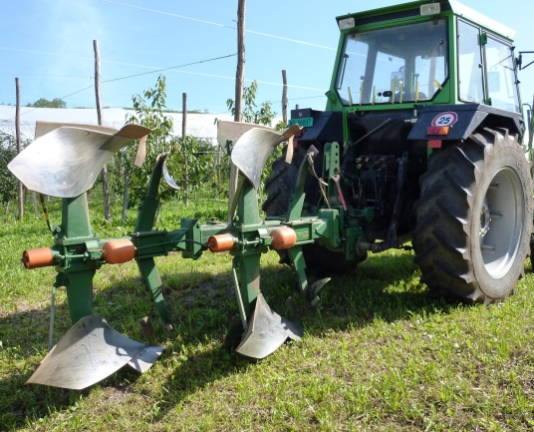
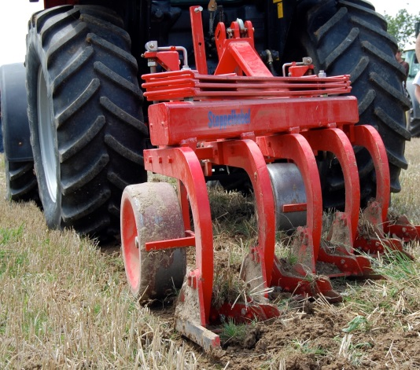
Reduced tillage and green manures for sustainable organic cropping systems TILMAN-ORG (2011-2014)
15 partners of 11 countries: Switzerland, France, Germany, Netherlands, Belgium, Luxemburg, United Kingdom, Estonia, Italy, Spain, Austria
Coordinator: Paul Mäder
Co-Coordinator: Christophe David
www.tilman-org.net

Slide 2
Achieved results
Farmers major concerns to apply reduced tillage (RT) are weeds, strongest motivation is improved soil fertility.
All organic farmers in the survey used crop rotation. Green manures were mainly planted in the temperate climate, no-tillage and reduced tillage was more used in the Mediterranean climate.
Meta-analysis: Yields are reduced by 7% under reduced tillage, and carbon stocks were increased, while weed infestation was found to be higher. Shallow ploughing comparable yields to deep inversion ploughing, but increases carbon stocks.
Case study soil quality: Soil organic carbon, microbial biomass and diversity more stratified under RT. Tendency to more N₂O emissions in reduced tillage.
Case study weeds: Weeds are more abundant in RT, but do not necessarily reduce yields. Model for functional traits of weeds has been developed. Site specific weed management strategies are needed.
Case study nutrient efficiency: 8% yield reduction in RT, and 15% lower soil mineral N in spring. NDICEA was adapted to simulate impacts of RT on C and N dynamics.
Prototyping and multi-criteria assessment: Strength of RT: positive influence on biodiversity. Major challenge is weed control (confirming farmers’ perceptions).

Slide 3
Conclusions
Weeds can be controlled when applying RT, green manure are a good strategy in that context.
Yields were not impeded if fertiliser regimes were adapted.
Further development: Optimise timing of nutrient supply, improve machinery, adapt RT systems to regions.
RT is especially advantageous for semi-arid regions.
Shallow ploughing is recommended.
Hybrid system (plough-RT) in temperate climate.
Higher soil organic carbon in upper-most soil layers reduces risk of erosion.
Identification of functional traits of weeds can help farmers benefit from within-field biodiversity.

